Slide 1

Superstore Sales Dashboard
Power BI Dashboard Project
Prepared By: Shubhangi Satav
Role: Data Analyst
Objective:
Develop an interactive dashboard to analyze sales, profit, customer behavior, and regional performance.

Slide 2
Dataset Overview
Dataset: Sample Superstore
Source: Kaggle / Tableau Sample Superstore
Main Columns:
• Order ID
• Order Date
• Customer Name
• Category
• Sub-Category
• Sales
• Profit
• Quantity
• Region
• Ship Mode

Slide 3
Business Problem
Business Goals:
• Identify top-selling products.
• Find the most profitable categories.
• Analyze regional performance.
• Understand customer segments.
• Monitor sales trends over time.
• Support data-driven decision making.

Slide 4
KPIs Defined
Key Performance Indicators:
• Total Sales-2.30M
• Total Profit- 286.40k
• Total Orders- 5k
• Total Quantity Sold-38k
• Profit Margin %- 12.47%

Slide 5
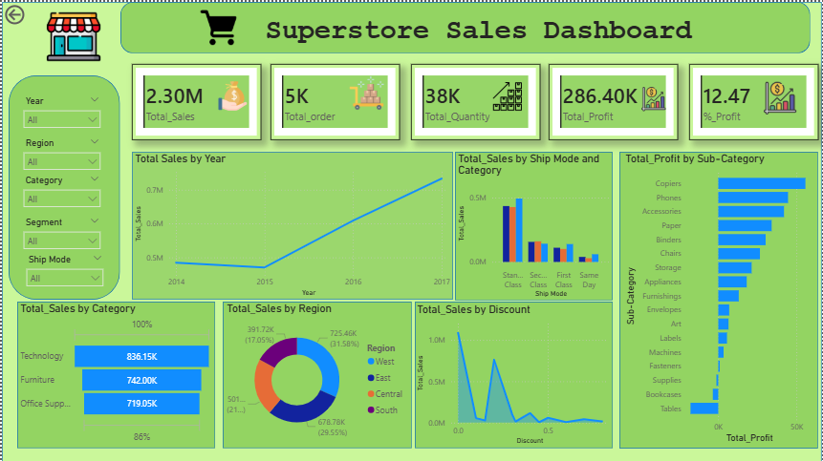
Dashboard Screenshot
Insert your Power BI dashboard screenshot here.
Dashboard Components:
• KPI Cards
• Sales Trend
• Category Analysis
• Regional Analysis
• Customer Segment Analysis
• Interactive Slicers

Slide 6
Key Insights
• Technology generated the highest sales.
• Consumer segment contributed the highest revenue.
• West region achieved the highest sales.
• Some products generated high sales but low profit.

Slide 7
Recommendations
• Focus on high-profit products.
• Reduce excessive discounts.
• Improve low-performing regions.
• Increase marketing during peak seasons.
• Optimize inventory planning.

Slide 8
Challenges Faced
• Data cleaning in Power Query.
• Creating DAX measures.
• Building relationships.
• Designing interactive visuals.
• Selecting meaningful KPIs.

Slide 9
Conclusion
Project Summary:
• Cleaned and transformed retail data.
• Built an interactive Power BI dashboard.
• Generated business insights.
• Provided actionable recommendations.
Skills Demonstrated:
Power BI, Power Query, DAX, Data Visualization, Business Intelligence.

Slide 10
Thank You!

